Slide 1
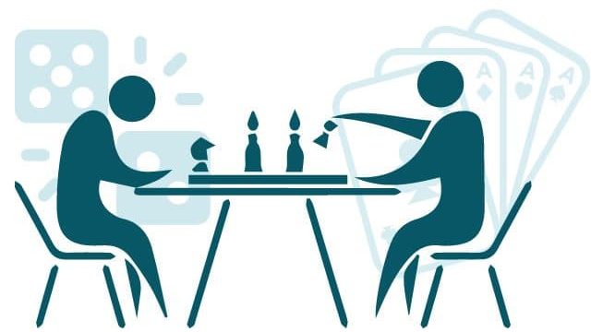
Game Theory Nine
BNN Error Orders
Continuous Strategy FP
Jacob Wyngaard

Slide 2
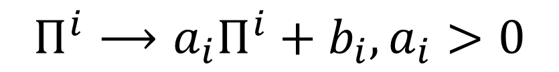
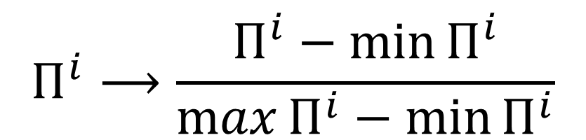
Normalizing Payoff Matrices
Nash Equilibrium is preserved under the following transformation of payoff matrices:
$$Π^{i}⟶a_{i}Π^{i}+b_{i},a_{i}>0$$
We can normalize the payoffs of each matrix to the interval [0,1] using the transformation:
$$Π^{i}⟶\frac{Π^{i}−\min{Π^{i}}}{\max{Π^{i}}−\min{Π^{i}}}$$

Slide 3
Why is Normalization Important?
By transforming our matrices at the start, negative expectation no longer affects our vertex enumeration algorithm or Lemke Howson algorithm!
Consider this example:
Player 1 Payoff Matrix
Player 2 Payoff Matrix
Player 2
Player 2
A
B
C
A
B
C
1
-2 | -7 | -3
-3 | -2 | 1
1 | -3 | -2
1
-2 | -3 | 1
1 | -2 | -3
-3 | 1 | -2
Player 1
Player 1
2
2
3
3

Slide 4
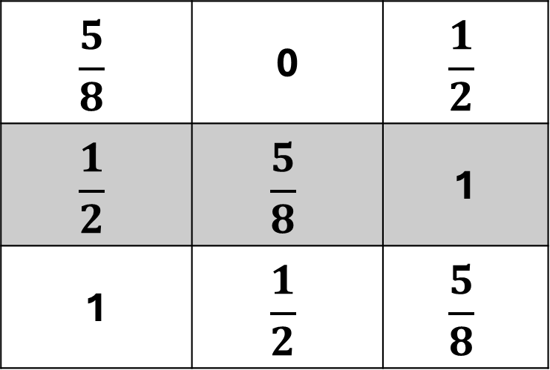
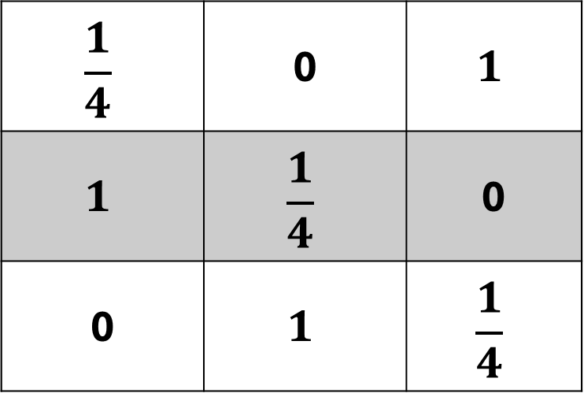
Normalization Example
Normalizing the payoff matrices, we get:
Player 1 Payoff Matrix
Player 2 Payoff Matrix
Player 2
Player 2
A
B
C
A
B
C
$$\frac{5}{8}$$ | 0 | $$\frac{1}{2}$$
$$\frac{1}{2}$$ | $$\frac{5}{8}$$ | 1
1 | $$\frac{1}{2}$$ | $$\frac{5}{8}$$
$$\frac{1}{4}$$ | 0 | $$1$$
$$1$$ | $$\frac{1}{4}$$ | 0
0 | $$1$$ | $$\frac{1}{4}$$
1
1
Player 1
Player 1
2
2
3
3

Slide 5


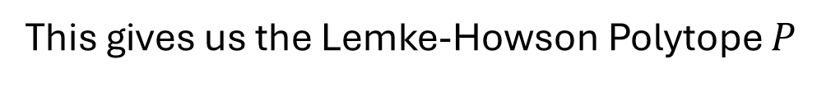


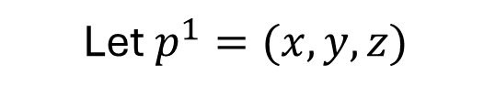



Normalization Example
This gives us the Lemke-Howson Polytope $P$
$$P=\left\{p^{1}∈ℝ^{m} \right| {(Π^{2})}^{T}p^{1}≤1, p^{1}≥0\}$$
Player 2 Payoff Matrix
Player 2
Let $p^{1}=(x,y,z)$
A
B
C
$P$ is the polytope bounded by:
$$\frac{1}{4}x+y ≤1$$
$$\frac{1}{4}$$ | 0 | $$1$$
$$1$$ | $$\frac{1}{4}$$ | 0
0 | $$1$$ | $$\frac{1}{4}$$
1
$$\frac{1}{4}y+z≤1$$
Player 1
$$x+\frac{1}{4}z ≤1$$
2
$$x ≥0$$
$$y ≥0$$
3
$$z ≥0$$

Slide 6
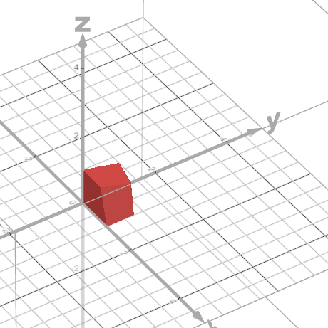
Normalization Example
This gives us the Lemke-Howson Polytope $P$
$$P=\left\{p^{1}∈ℝ^{m} \right| {(Π^{2})}^{T}p^{1}≤1, p^{1}≥0\}$$
Let $p^{1}=(x,y,z)$
$P$ is the polytope bounded by:
$$\frac{1}{4}x+y ≤1$$
$$\frac{1}{4}y+z≤1$$
$$x+\frac{1}{4}z ≤1$$
$$x ≥0$$
$$y ≥0$$
$$z ≥0$$

Slide 7


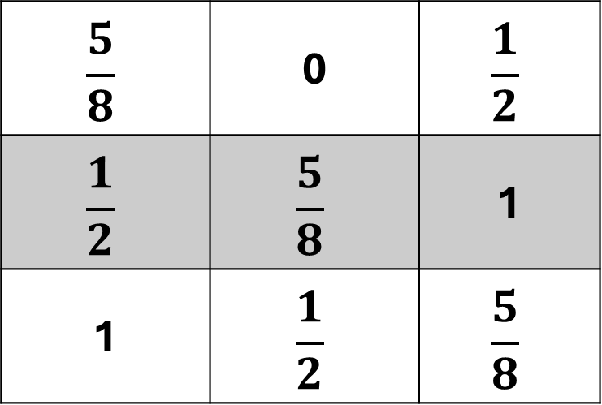



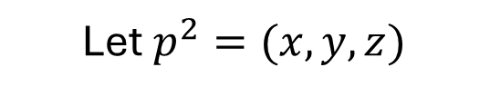

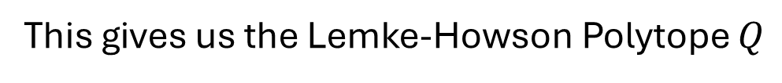

Normalization Example
This gives us the Lemke-Howson Polytope $Q$
Player 1 Payoff Matrix
$$Q=\left\{p^{2}∈ℝ^{n} \right|Π^{1}p^{2}≤1, p^{2}≥0\}$$
Player 2
Let $p^{2}=(x,y,z)$
A
B
C
$Q$ is the polytope bounded by:
$$\frac{5}{8}$$ | 0 | $$\frac{1}{2}$$
$$\frac{1}{2}$$ | $$\frac{5}{8}$$ | 1
1 | $$\frac{1}{2}$$ | $$\frac{5}{8}$$
$$\frac{5}{8}x+\frac{1}{2}z ≤1$$
1
$$\frac{1}{2}x+\frac{5}{8}y+z≤1$$
Player 1
2
$$x+\frac{1}{2}y+\frac{5}{8}z≤1$$
$$x ≥0$$
3
$$y ≥0$$
$$z ≥0$$

Slide 8
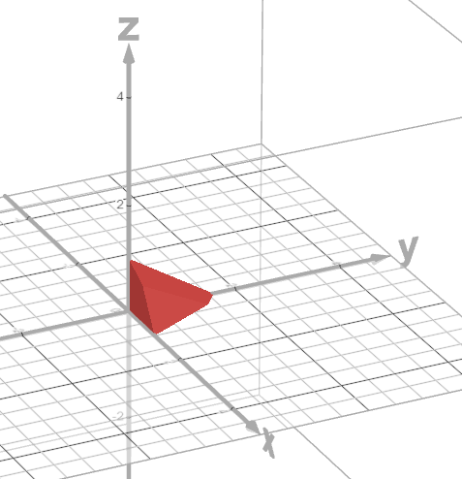
Normalization Example
This gives us the Lemke-Howson Polytope $Q$
$$Q=\left\{p^{2}∈ℝ^{n} \right|Π^{1}p^{2}≤1, p^{2}≥0\}$$
Let $p^{2}=(x,y,z)$
$Q$ is the polytope bounded by:
$$\frac{5}{8}x+\frac{1}{2}z ≤1$$
$$\frac{1}{2}x+\frac{5}{8}y+z≤1$$
$$x+\frac{1}{2}y+\frac{5}{8}z≤1$$
$$x ≥0$$
$$y ≥0$$
$$z ≥0$$

Slide 9
RK4 Error Order with Simple BNN System
Two players each with two strategies, one of which strictly dominates the other
Player 1 Payoff Matrix
Player 2 Payoff Matrix
Player 2
Player 2
A
B
A
B
1
1 | 2
3 | 4
1
5 | 7
6 | 8
Player 1
Player 1
2
2
Player 1 Strategy:${ p}^{1}=(x^{1},y^{1})$ Player 2 Strategy:${ p}^{2}=(x^{2},y^{2})$

Slide 10


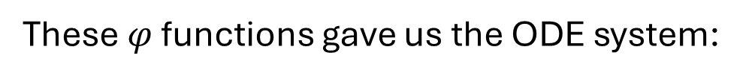
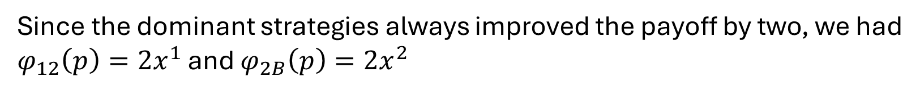


RK4 Error Order with Simple BNN System
The strict dominance of Strategy 2 over Strategy 1 gave us that $φ_{11}\left(p\right)=0$
The strict dominance of Strategy B over Strategy A gave us that $φ_{2A}\left(p\right)=0$
Since the dominant strategies always improved the payoff by two, we had
$φ_{12}\left(p\right)=2x^{1}$ and $φ_{2B}\left(p\right)=2x^{2}$
These $φ$ functions gave us the ODE system:
$$\dot{x^{1}}=−2({x^{1})}^{2}$$
$$\dot{y^{1}}=2({x^{1})}^{2}$$
$$\dot{x^{2}}=−2({x^{2})}^{2}$$
$$\dot{y^{2}}=2({x^{2})}^{2}$$

Slide 11

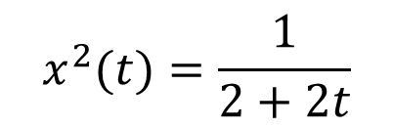


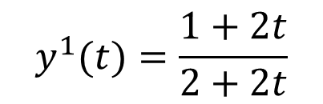

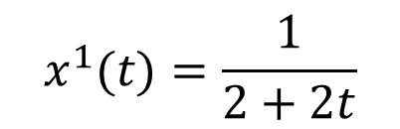




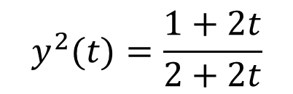
Actual Solution of BNN System
I first considered the actual solution of this BNN ODE
The ODE system:
$$\dot{x^{1}}=−2({x^{1})}^{2}$$
$$\dot{y^{1}}=2({x^{1})}^{2}$$
$$\dot{x^{2}}=−2({x^{2})}^{2}$$
$$\dot{y^{2}}=2({x^{2})}^{2}$$
subject to initial conditions:
$$x^{1}(0)=1/2$$
$$y^{1}(0)=1/2$$
$$x^{2}(0)=1/2$$
$$y^{2}(0)=1/2$$
Has the exact solution:
$$x^{1}(t)=\frac{1}{2+2t}$$
$$y^{1}(t)=\frac{1+2t}{2+2t}$$
$$x^{2}(t)=\frac{1}{2+2t}$$
$$y^{2}(t)=\frac{1+2t}{2+2t}$$

Slide 12
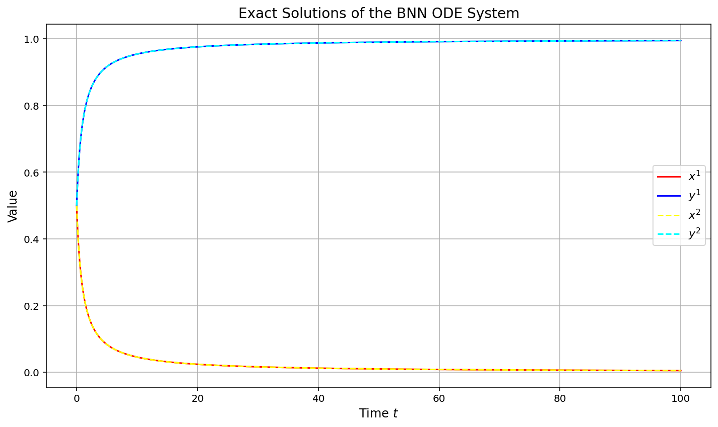
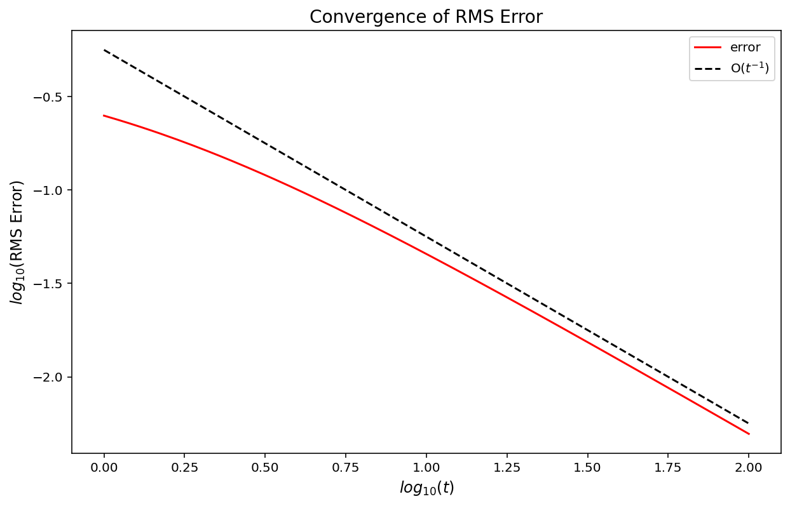
Convergence of Actual Solution to Nash Equilibrium
$O(t^{−1})$ Convergence of Actual Solution to Nash Equilibrium
Slow!

Slide 13
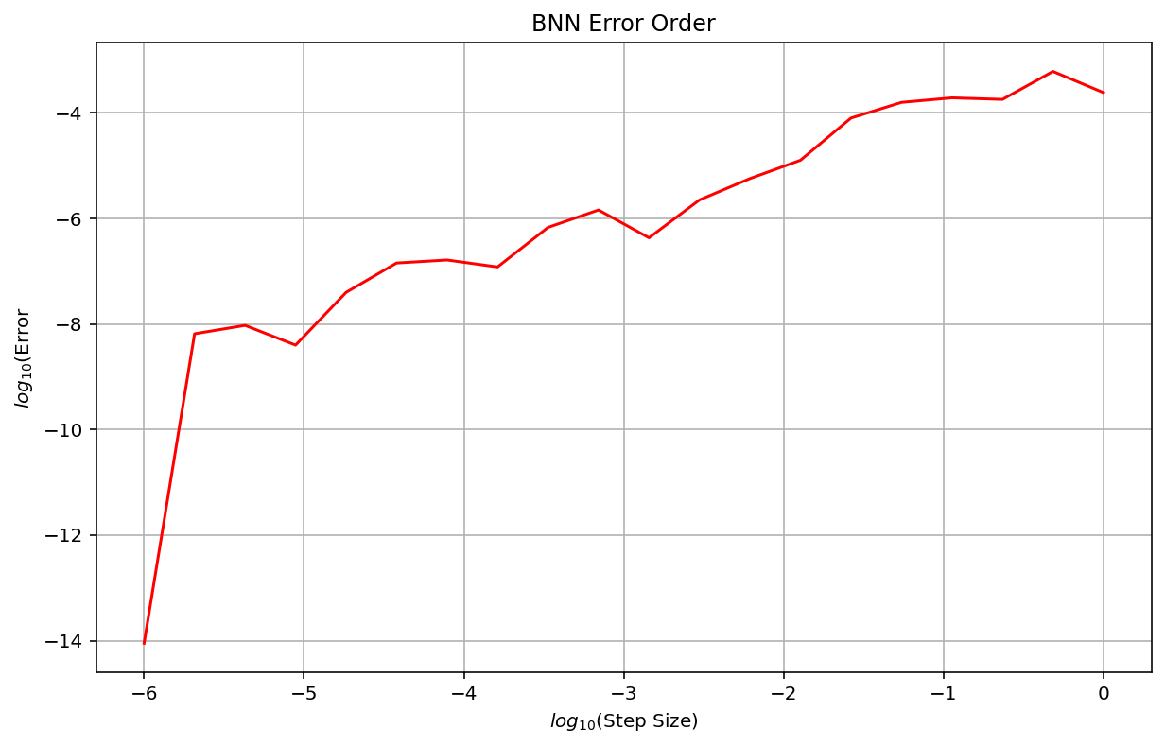
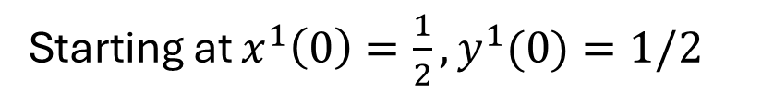
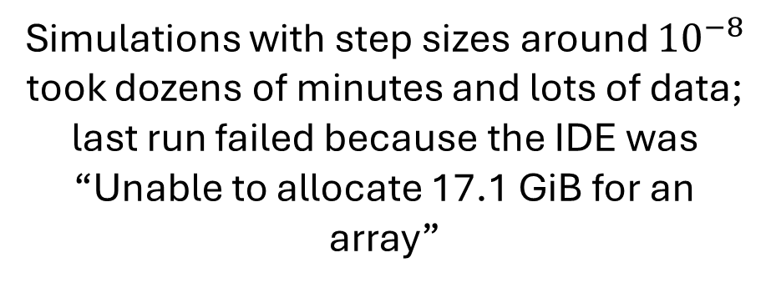
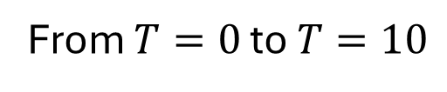
Convergence of RK 4 Solution to Actual Solution
Starting at $x^{1}\left(0\right)=\frac{1}{2},y^{1}(0)=1/2$
From $T=0$ to $T=10$
Simulations with step sizes around ${10}^{−8}$ took dozens of minutes and lots of data; last run failed because the IDE was “Unable to allocate 17.1 GiB for an array”

Slide 14
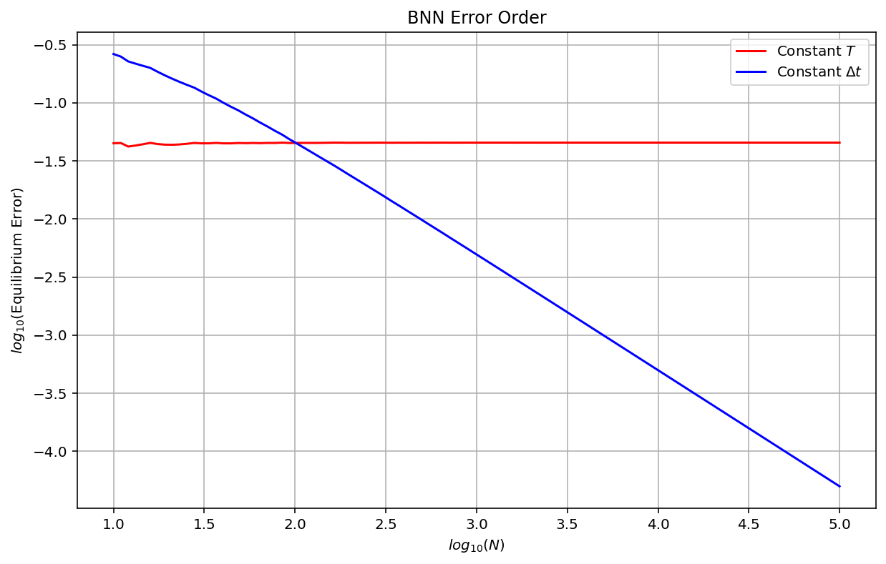

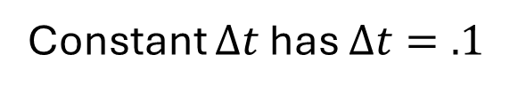
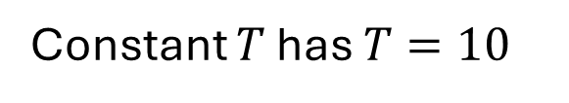
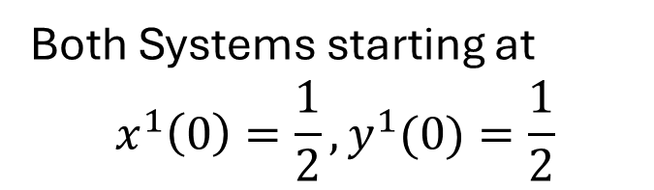
What’s More Important…
$Δt$ or $T$?
RK 4 Method
Both Systems starting at
$$x^{1}\left(0\right)=\frac{1}{2},y^{1}(0)=\frac{1}{2}$$
Constant $T$ has $T=10$
Constant $Δt$ has $Δt=.1$

Slide 15
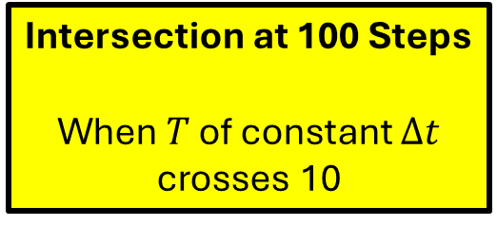

What’s More Important…
$Δt$ or $T$?
RK 4 Method
Both Systems starting at
$$x^{1}\left(0\right)=\frac{1}{2},y^{1}(0)=\frac{1}{2}$$
Intersection at 100 Steps
When $T$ of constant $Δt$ crosses 10
Constant $T$ has $T=10$
Constant $Δt$ has $Δt=.1$
$T$ matters more than $Δt$

Slide 16
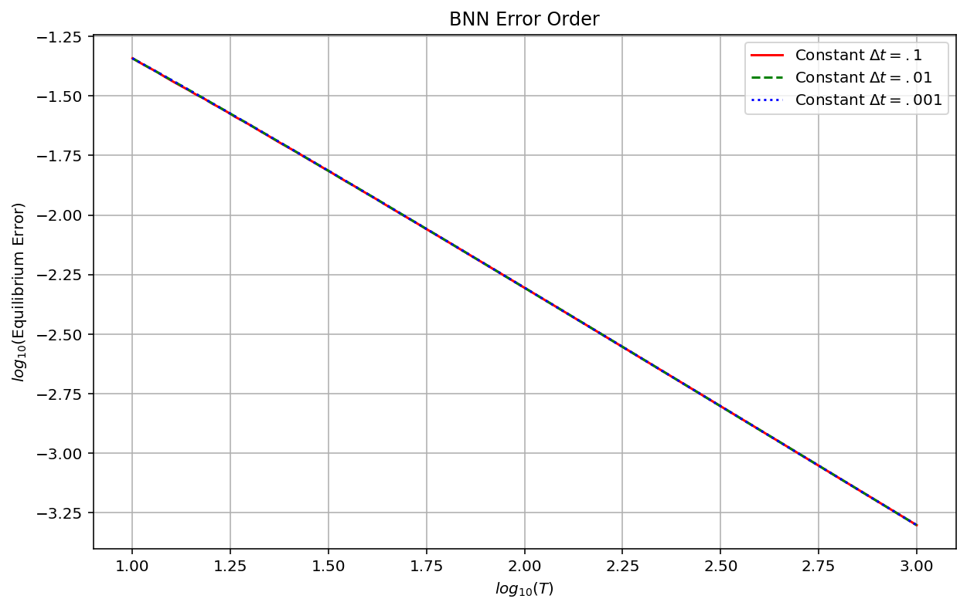
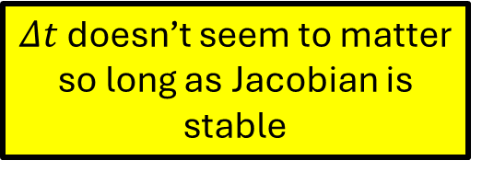
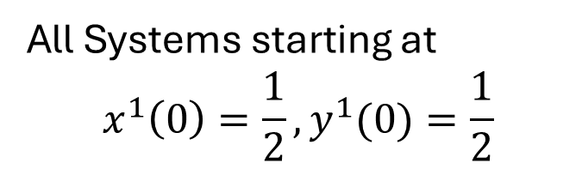
What’s More Important…
$Δt$ or $T$?
RK 4 Method
All Systems starting at
$$x^{1}\left(0\right)=\frac{1}{2},y^{1}(0)=\frac{1}{2}$$
$Δt$ doesn’t seem to matter so long as Jacobian is stable

Slide 17
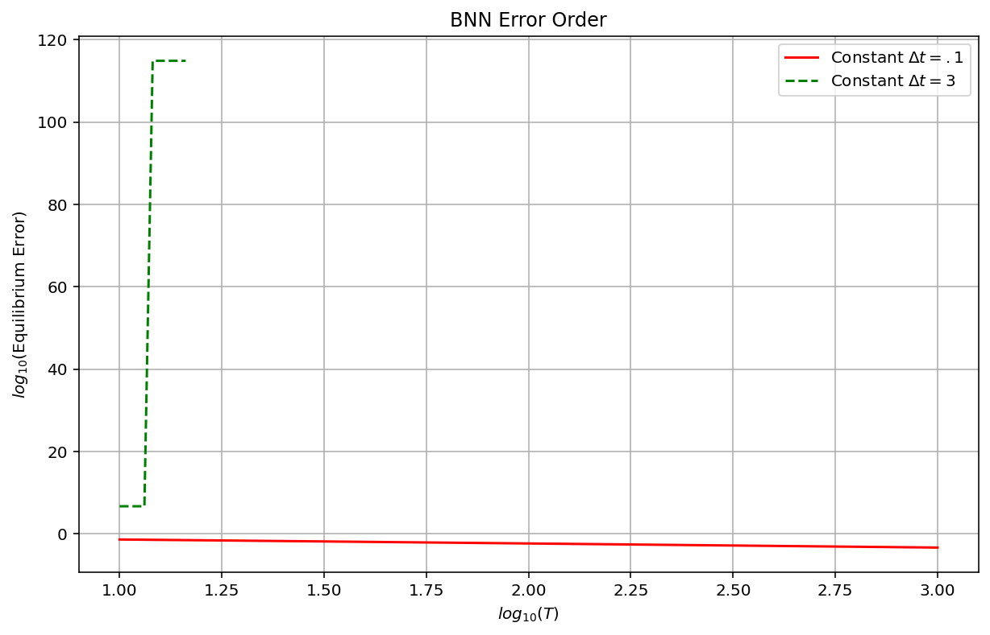
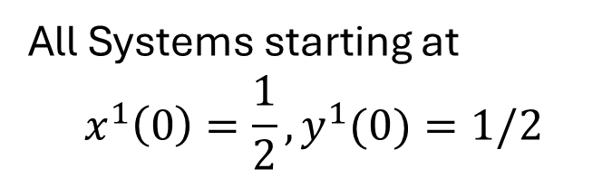
What’s More Important…
$Δt$ or $T$?
RK 4 Method
All Systems starting at
$$x^{1}\left(0\right)=\frac{1}{2},y^{1}(0)=1/2$$
$Δt$ doesn’t seem to matter so long as Jacobian is stable

Slide 18
RK4 Error Order with More Complicated BNN System
Two players each with two strategies, only one of which has a strictly dominant strategy
Player 1 Payoff Matrix
Player 2 Payoff Matrix
Player 2
Player 2
A
B
A
B
1
1 | 2
3 | 4
1
7 | 5
6 | 8
Player 1
Player 1
2
2
Player 1 Strategy:${ p}^{1}=(x^{1},y^{1})$ Player 2 Strategy:${ p}^{2}=(x^{2},y^{2})$

Slide 19
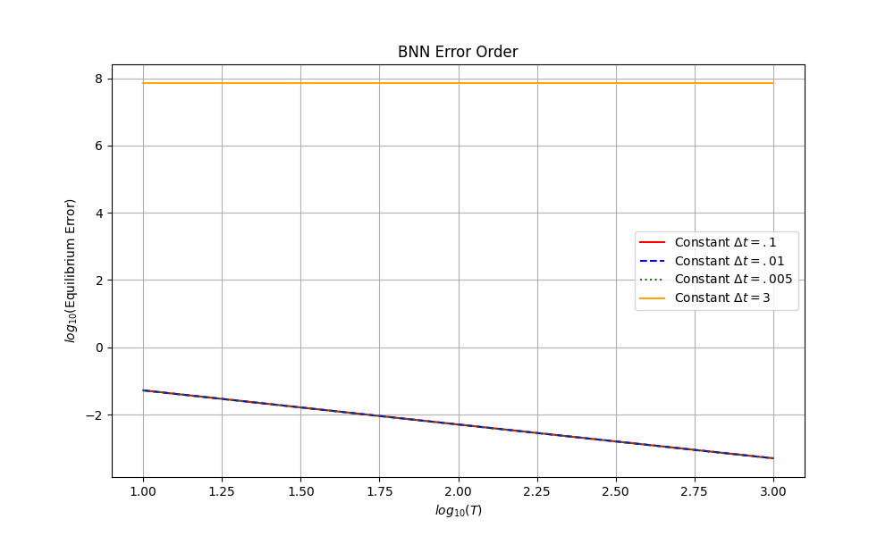

What’s More Important…
$Δt$ or $T$?
RK 4 Method
All Systems starting at
$$x^{1}\left(0\right)=\frac{1}{2},y^{1}(0)=\frac{1}{2}$$
$Δt$ doesn’t seem to matter so long as Jacobian is stable

Slide 20
RK4 Error Order with Even More Complicated BNN System
Two players each with two strategies, neither with a strictly dominant strategy
Player 1 Payoff Matrix
Player 2 Payoff Matrix
Player 2
Player 2
A
B
A
B
1
2 | 3
4 | 1
1
7 | 5
6 | 8
Player 1
Player 1
2
2
Player 1 Strategy:${ p}^{1}=(x^{1},y^{1})$ Player 2 Strategy:${ p}^{2}=(x^{2},y^{2})$

Slide 21
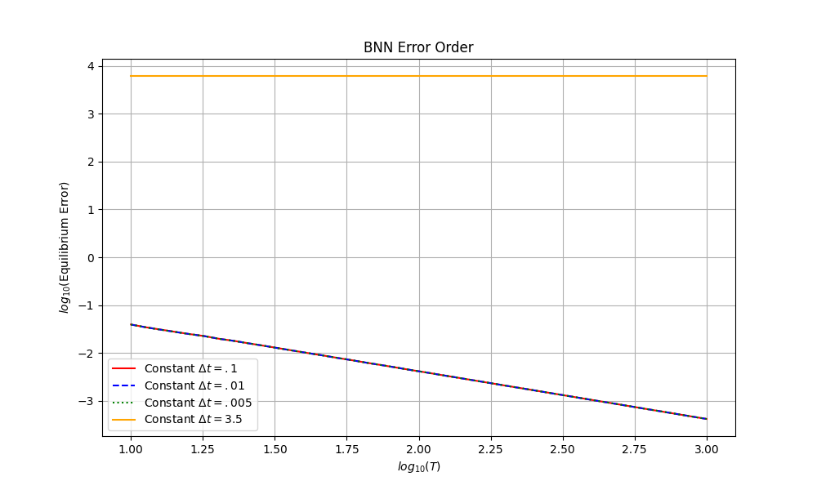
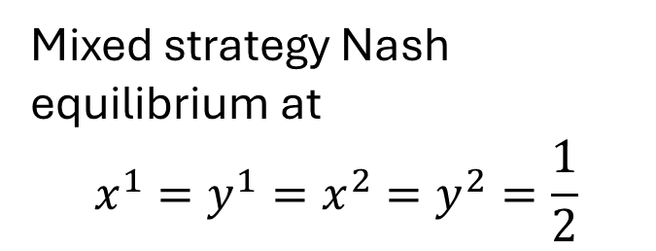
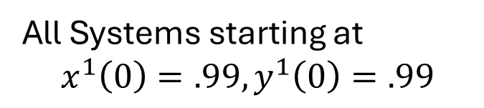
What’s More Important…
$Δt$ or $T$?
RK 4 Method
All Systems starting at
$$x^{1}\left(0\right)=.99,y^{1}\left(0\right)=.99$$
Mixed strategy Nash equilibrium at
$$x^{1}=y^{1}=x^{2}=y^{2}=\frac{1}{2}$$
$Δt$ doesn’t seem to matter so long as Jacobian is stable

Slide 22
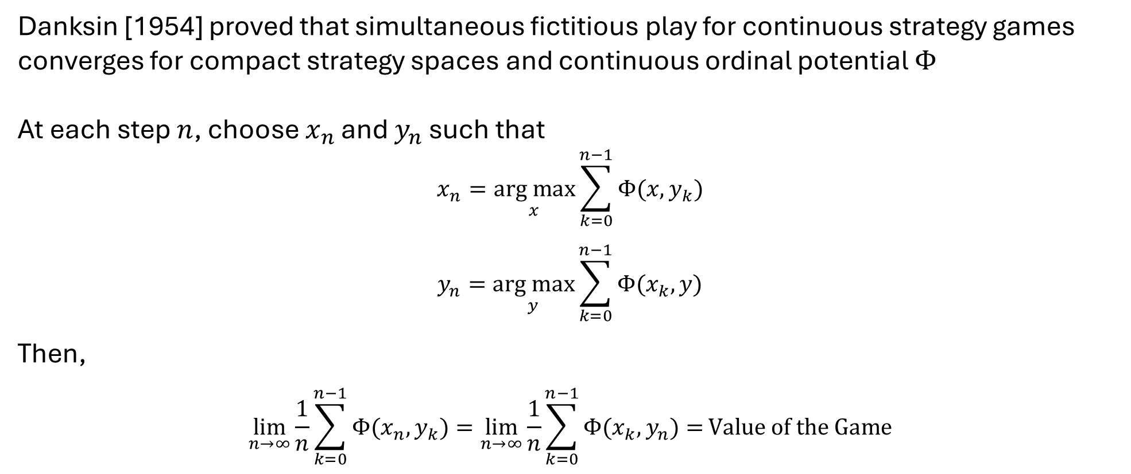
Fictitious Play with Continuous Strategies
Danksin [1954] proved that simultaneous fictitious play for continuous strategy games converges for compact strategy spaces and continuous ordinal potential $Φ$
At each step $n$, choose $x_{n}$ and $y_{n}$ such that
$$x_{n}=\underset{x}{arg max}{\sum_{k=0}^{n−1}{Φ(x,y_{k})}}$$
$$y_{n}=\underset{y}{arg max}{\sum_{k=0}^{n−1}{Φ(x_{k},y)}}$$
Then,
$$\lim_{n→∞}\frac{1}{n}{\sum_{k=0}^{n−1}{Φ(x_{n},y_{k})}=\lim_{n→∞}\frac{1}{n}{\sum_{k=0}^{n−1}{Φ(x_{k},y_{n})}=}}Value of the Game$$

Slide 23
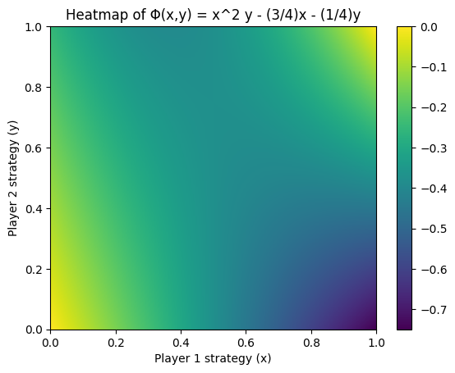
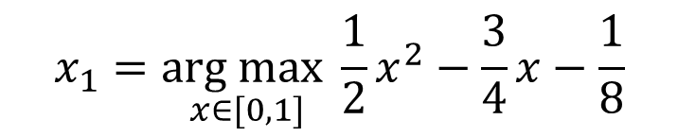

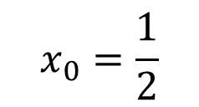






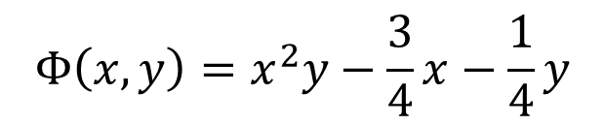
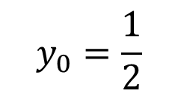
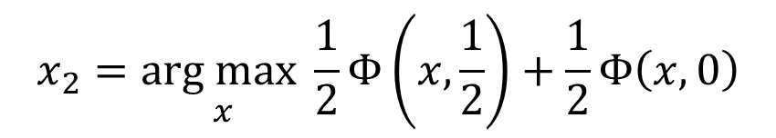
Simultaneous Fictitious Play with Continuous Strategies
$$n=0$$
$$x_{0}=\frac{1}{2}$$
$$y_{0}=\frac{1}{2}$$
$$n=1$$
$$x_{1}=\underset{x∈[0,1]}{arg max}{\frac{1}{2}x}^{2}−\frac{3}{4}x−\frac{1}{8}$$
$$x_{1}=0$$
$$y_{1}=\underset{y∈[0,1]}{arg max}−\frac{1}{4}y$$
$$y_{1}=0$$
$$n=2$$
$$x_{2}=\underset{x}{arg max}\frac{1}{2}Φ\left(x,\frac{1}{2}\right)+\frac{1}{2}Φ\left(x,0\right)$$
$$Φ\left(x,y\right)=x^{2}y−\frac{3}{4}x−\frac{1}{4}y$$
$$x_{2}=0$$

Slide 24
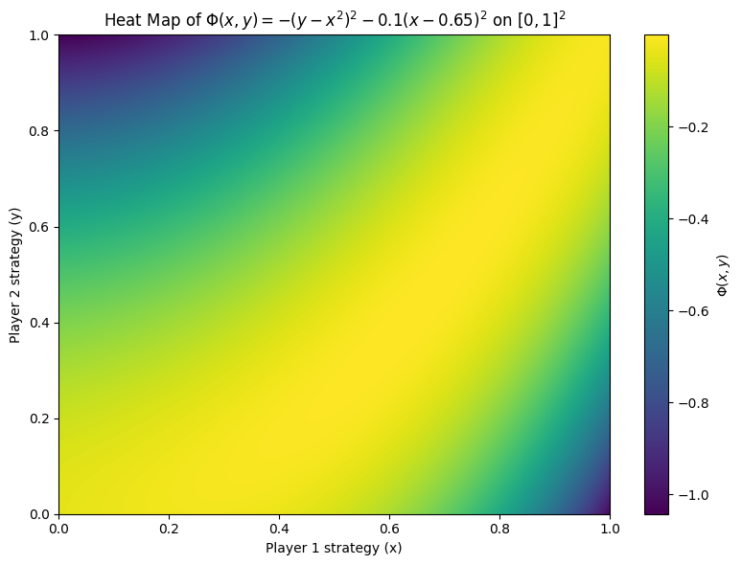
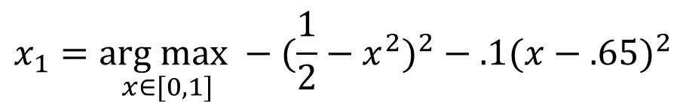
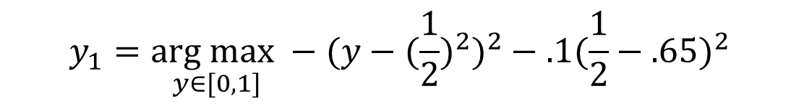
Simultaneous Fictitious Play with Cont. Strategies
A More Interesting Example
$$n=0$$
$$x_{0}=\frac{1}{2}$$
$$y_{0}=\frac{1}{2}$$
$$n=1$$
$$x_{1}=\underset{x∈[0,1]}{arg max}−({\frac{1}{2}−x^{2})}^{2}−.1({x−.65)}^{2}$$
$$x_{1}≈.7044$$
$$y_{1}=\underset{y∈[0,1]}{arg max}−({y−{(\frac{1}{2})}^{2})}^{2}−.1({\frac{1}{2}−.65)}^{2}$$
$$y_{1}=.25$$
$$Φ\left(x,y\right)=−({y−x^{2})}^{2}−.1({x−.65)}^{2}$$

Slide 25
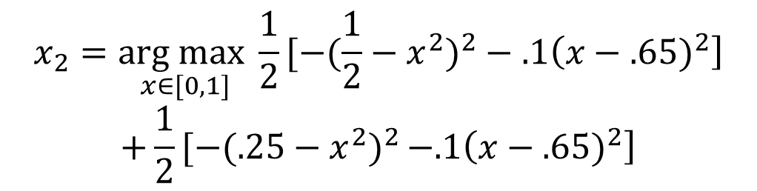





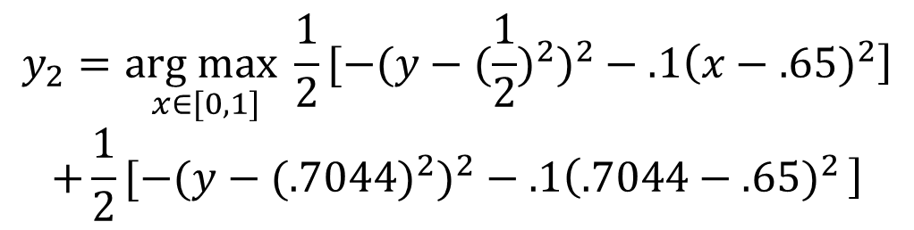
Simultaneous Fictitious Play with Cont. Strategies
A More Interesting Example
$$n=2$$
$$x_{1}≈.7044$$
$$y_{1}=.25$$
$$x_{2}=\underset{x∈[0,1]}{arg max}\frac{1}{2}[−({\frac{1}{2}−x^{2})}^{2}−.1\left({x−.65)}^{2}\right]$$
$$+\frac{1}{2}[−({.25−x^{2})}^{2}−.1\left({x−.65)}^{2}\right]$$
$$y_{2}=\underset{x∈[0,1]}{arg max}\frac{1}{2}[−({y−{(\frac{1}{2})}^{2})}^{2}−.1\left({x−.65)}^{2}\right]$$
$$+\frac{1}{2}[−({y−{(.7044)}^{2})}^{2}−.1\left({.7044−.65)}^{2}\right]$$
$$Φ\left(x,y\right)=−({y−x^{2})}^{2}−.1({x−.65)}^{2}$$
$$x_{2}≈.615$$
$$y_{1}≈.3731$$

Slide 26

Simultaneous Fictitious Play with Cont. Strategies
A More Interesting Example
$$n=2$$
$$x_{1}≈.7044$$
$$y_{1}=.25$$
$$x_{2}=\underset{x∈[0,1]}{arg max}\frac{1}{2}[−({\frac{1}{2}−x^{2})}^{2}−.1\left({x−.65)}^{2}\right]$$
$$+\frac{1}{2}[−({.25−x^{2})}^{2}−.1\left({x−.65)}^{2}\right]$$
$$y_{2}=\underset{x∈[0,1]}{arg max}\frac{1}{2}[−({y−{(\frac{1}{2})}^{2})}^{2}−.1\left({x−.65)}^{2}\right]$$
$$+\frac{1}{2}[−({y−{(.7044)}^{2})}^{2}−.1\left({.7044−.65)}^{2}\right]$$
Simultaneous Fictitious Play Converges to the Actual Solution
$$(.65,.4225)$$
$$Φ\left(x,y\right)=−({y−x^{2})}^{2}−.1({x−.65)}^{2}$$
$$x_{2}≈.615$$
$$y_{1}≈.3731$$

Slide 27

Fictitious Play with Continuous Strategies
Which converges faster: alternating fictitious play or simultaneous?
No universal answer, although alternating fictitious play has stronger convergence guarantees and can avoid “cycling”
Related to open area in AI research:
Multi-Agent Reinforcement Learning
Neural Fictitious Self-Play
FP more accurately models how agents arrive at optimal strategies

Slide 28

The Advantage of Fictitious Play
“Nash equilibrium assumes that players can solve highly complex fixed-point problems, which is implausible as a model of actual human reasoning.”
What if we used Ockham’s Razor and limited complexity of learned strategies? Maybe with information theory?

Slide 29



Fictitious Play with Continuous Strategies
What if we assumed that each player had a probability measure?
$${EV}_{1}\left(ρ_{1},ρ_{2}\right)=\iint{u_{1}\left(x,y\right)dρ_{1}\left(x\right)dρ_{2}(y)}$$
Since the partial derivative of $Φ\left(x,y\right)$ and $u_{1}(x)$ with respect to $x$ are equivalent:
$$\underset{ρ_{1}}{arg max}\iint{u_{1}\left(x,y\right)dρ_{1}\left(x\right)dρ_{2}(y)}=\underset{ρ_{1}}{arg max}\iint{Φ\left(x,y\right)dρ_{1}\left(x\right)dρ_{2}(y)}$$
Continuously differentiable ${Φ,ρ}_{1},ρ_{2}$functions would allow us to use Euler Lagrange equations to update our probability densities
$$ρ_{1}^{n+1}=\underset{ρ_{1}}{arg max}{\iint{Φ\left(x,y\right)dρ_{1}\left(x\right)dρ_{2}^{n}(y)}}$$

Slide 30


Fictitious Play with Continuous Strategies
Continuously differentiable ${Φ,ρ}_{1},ρ_{2}$functions would allow us to use Euler Lagrange equations to update our probability densities
$$ρ_{1}^{n+1}=\underset{ρ_{1}}{arg max}{\iint{Φ\left(x,y\right)dρ_{1}\left(x\right)dρ_{2}^{n}(y)}}$$
But…
$ρ_{1}^{n+1}$ is just a Dirac measure with its entire mass centered at
$\underset{x}{arg max} \int{Φ\left(x,y\right)dρ_{2}^{n}(y)}$
We know this arg max is attained because of the compactness of the strategy sets

Slide 31

Fluid Dynamics and Game Theory
Most prominent connection is mean field game theory
Luo and Song established the equivalence between Mean Field Games and a class of PDE systems closely related to compressible Navier-Stokes equations
Uncertainty prevents “density collapse” on previous slide. This uncertainty is added by updating each individual by an independent stochastic differential equation
state
control
population

Slide 32


Fluid Dynamics and Game Theory
Compressible Navier Stokes
Considered PDE Systems
Fokker Planck Equation to represent white noise

Slide 33

Fluid Dynamics and Game Theory
Considered PDE Systems
Fokker Planck Equation to represent white noise
Mean Field Game System

